Slide 1
Strategic Tic Tac Toe
By X’s and O’s and C’s

Slide 2
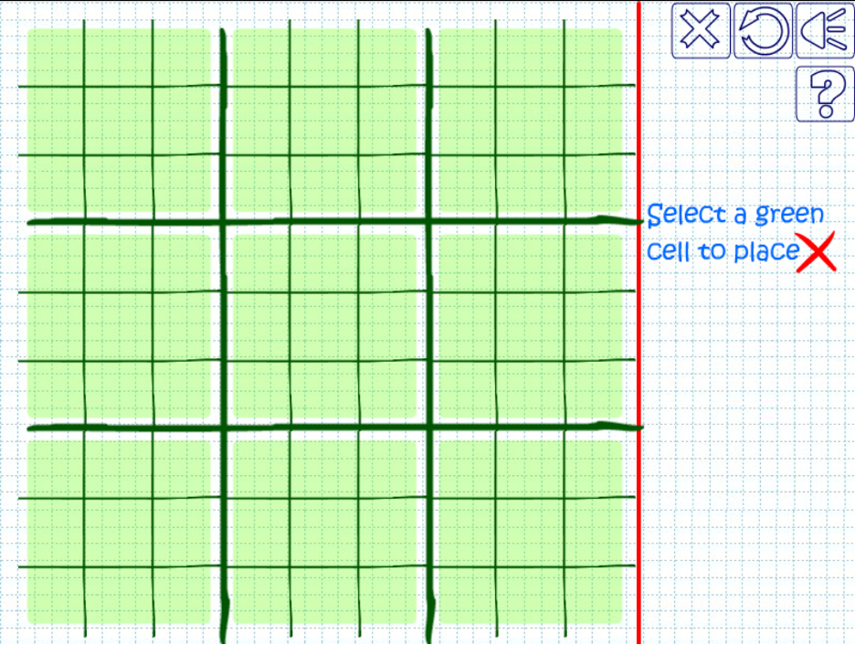
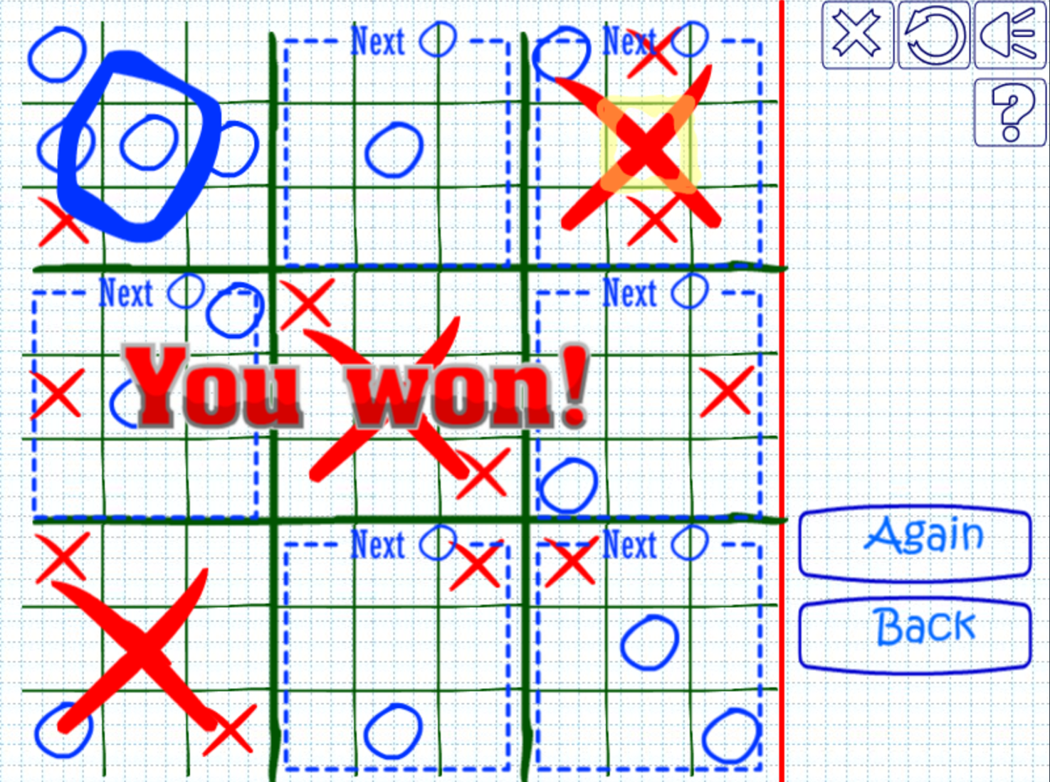
Overview of game
Notes:
Type of game (why), how it work, basic how to play

Slide 3
Current Implementation
Game
Two Player
Basic Menu
Saving/Loading
Fine tuned display

Slide 4
Future implementation(s)
Animations
Multiple saves
Single Player
How to play
Board highlights next square
Logic??

Slide 5
What worked
Intuitiveness
Win conditions
Simple controls
Jumping boards
Save/Load with characters
Some integration

Slide 6
What didn’t
GameBoard -> TicTacBoard
Saving objects to file
GitHub
Consistent logic (inputs)

Slide 7
Obstacles
Displaying
Segmentation Fault
Saving/load game
Same code doing different things
Where to use polymorphism
Ubuntu
Collaboration

Slide 8
Next Time
Test collaboration tool
Same page
Early Start
Working Ubuntu on all devices

Slide 9
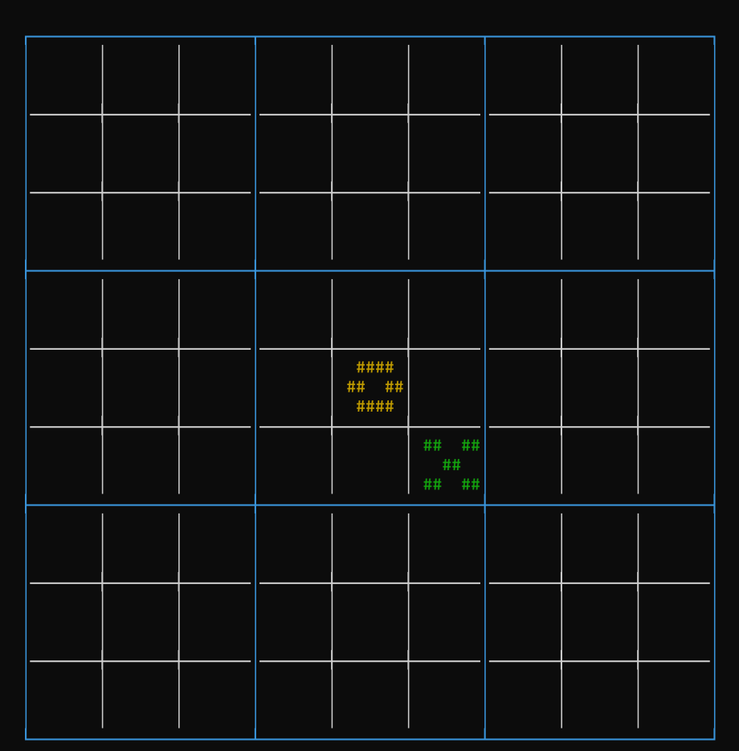
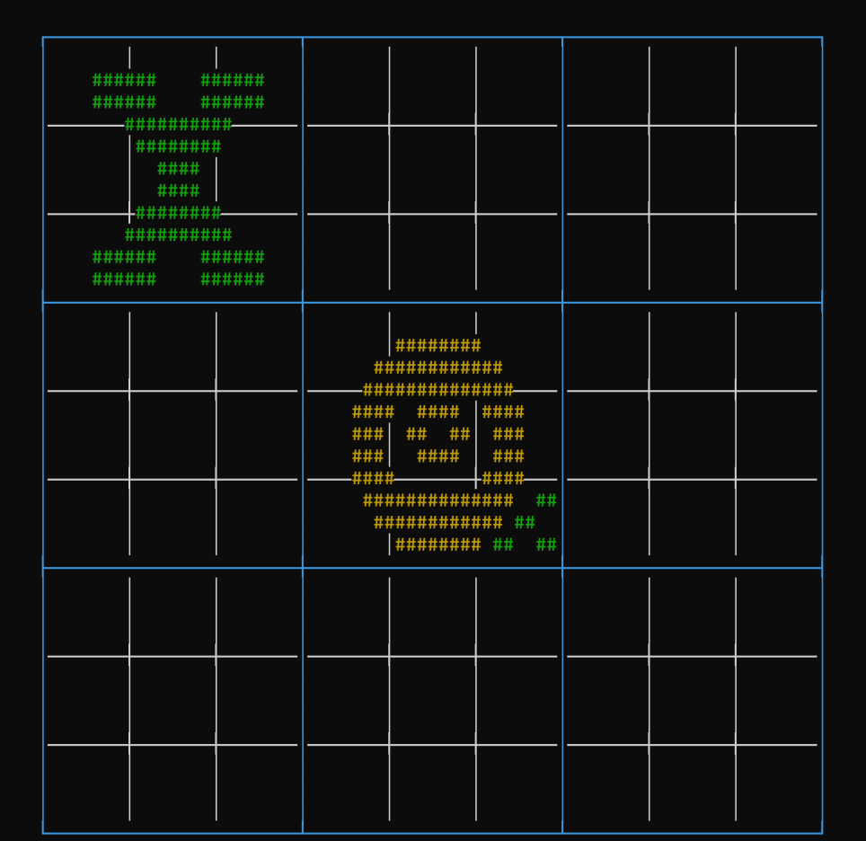
Our game demo

